Slide 1


Lease Management: Salesforce Implementation Project
This project showcases the successful implementation of Salesforce to streamline and optimize a company's lease management processes, driving efficiency and enhancing visibility across the organization.
by MASS MANI

Slide 2

Project Overview
1
Discovery
Comprehensive analysis of the existing lease management system and identification of pain points and improvement opportunities.
2
Design
Collaborative design of the Salesforce-based solution, aligning with the company's unique requirements and industry best practices.
3
Implementation
Seamless integration of the Salesforce platform, ensuring a smooth transition and user adoption.

Slide 3
Business Objectives
Improve Visibility
Streamline Workflows
Enhance Compliance
Provide a centralized platform to track and manage all lease-related information, enhancing decision-making capabilities.
Automate and standardize lease management processes, reducing manual effort and errors.
Ensure adherence to regulatory requirements and contractual obligations through robust tracking and reporting.

Slide 4

Salesforce Key Features Leveraged
1
Lease Object
2
Workflow Automation
Centralized platform to store and manage all lease-related data, including contract details, payment schedules, and key dates.
Automated processes for lease renewals, property inspections, and compliance tracking, ensuring timely actions and notifications.
3
Reporting and Analytics
4
Integration with Other Systems
Robust reporting capabilities to generate custom lease reports, monitor KPIs, and support informed decision-making.
Seamless integration with financial systems, allowing for accurate lease-related accounting and invoicing processes.

Slide 5
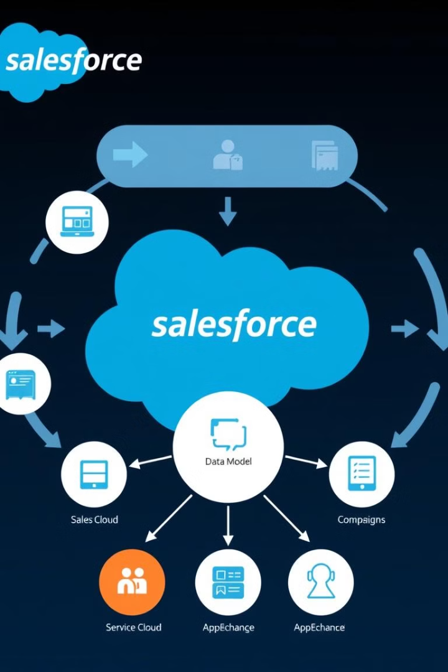
Salesforce Concepts Utilized
Custom Objects
Workflow Rules
Tailored Salesforce objects to capture unique lease data and manage the full lifecycle of lease agreements.
Automated actions and notifications triggered by specific lease events or milestones, ensuring timely follow-ups.
Lightning Components
Reporting and Dashboards
Customized Lightning components to enhance the user experience and provide intuitive lease management functionalities.
Comprehensive reporting capabilities and interactive dashboards to track key lease performance indicators.

Slide 6





Solution Design Approach
Requirements Gathering
Solution Architecture
Agile Implementation
Change Management
Comprehensive understanding of the client's lease management processes, pain points, and desired outcomes.
Design of the Salesforce-based solution, including data models, workflows, and integration points.
Iterative development and deployment, ensuring continuous feedback and alignment with evolving requirements.
Effective user training and adoption strategies to facilitate a smooth transition to the new system.

Slide 7
Testing and Validation Methodology
Unit Testing
Integration Testing
User Acceptance Testing
Comprehensive testing of individual Salesforce components and functionalities to ensure their proper functioning.
Verification of seamless data exchange and process integration between the Salesforce solution and external systems.
Validation of the solution's alignment with user requirements and end-to-end lease management workflows.

Slide 8





Key Scenarios Addressed by Salesforce
Lease Renewal Tracking
Lease Documentation Management
Lease Performance Reporting
Lease Payment Management
Automated notifications and reminders for upcoming lease renewals, ensuring timely action and minimizing disruption.
Centralized repository for all lease-related documents, providing easy access and compliance assurance.
Comprehensive reporting and analytics to monitor key lease metrics, support strategic decision-making.
Automated tracking and reconciliation of lease payments, ensuring timely payments and reducing risks.

Slide 9

Challenges and Lessons Learned
1
Data Migration
2
User Adoption
3
Integrations
Developing a robust data migration strategy to efficiently transfer historical lease data to the new Salesforce platform.
Implementing comprehensive training programs and change management strategies to ensure seamless user adoption.
Carefully planning and executing the integration between Salesforce and the client's existing financial and ERP systems.

Slide 10

Conclusion and Next Steps
Improved Visibility and Control
Ongoing Optimization
Scalable Platform
The team will continue to identify opportunities for further optimization and integration with other business systems.
The Salesforce platform offers the flexibility and scalability to accommodate the client's evolving lease management requirements.
The Salesforce-based lease management solution has provided the client with greater visibility, streamlined workflows, and enhanced compliance.

